Slide 1
Researching Videogaming & Esports as a Window to Cognitive Plasticity
Claudia von Bastian, PhD
Eleanor Hyde, MSc
1 November 2023

Slide 2

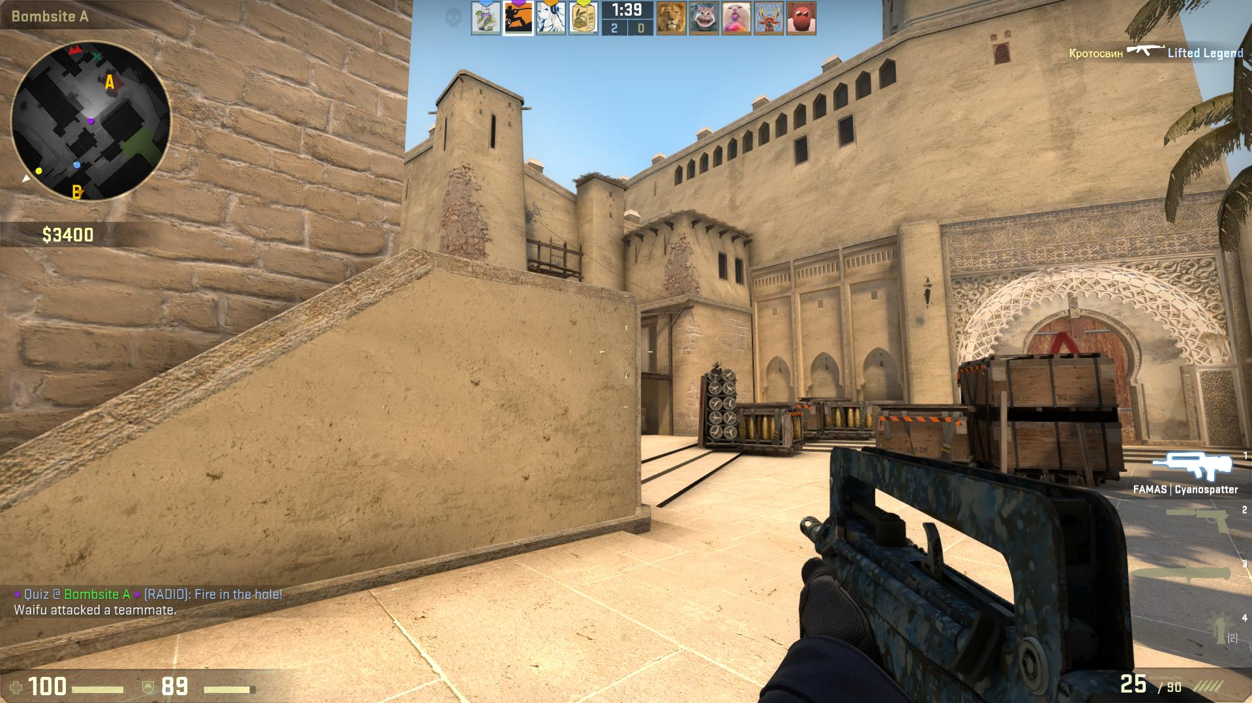

Overview
Introduction to Cognitive Plasticity
Videogaming & Esports as Brain Training
Processing Speed in Counter-Strike Players

Slide 3
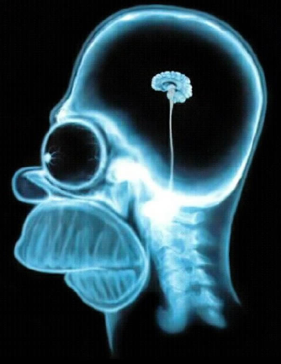
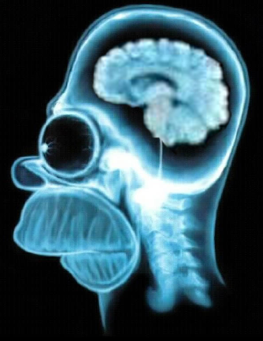

“Brain training”

Slide 4

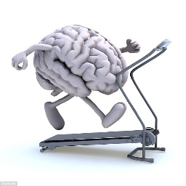
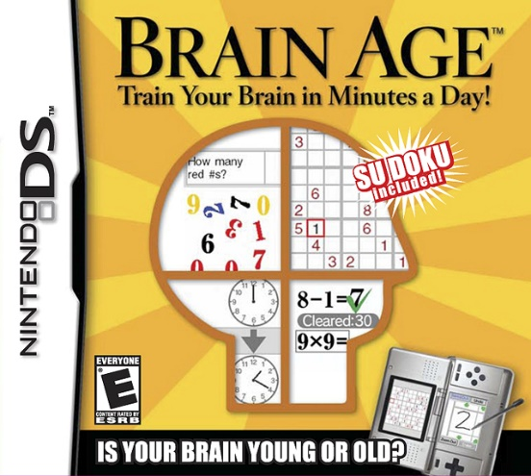




“Brain training”

Slide 5
“Brain training”
Training
Reasoning
Attention
Everyday Cognition
Cognitive Deficitis
Academic Success

Slide 6

transfer improvements in practiced tasks lead to improvements in unpracticed tasks
Photo by Moritz Kindler

Slide 7
Training and transfer
Practice
Trained task
Near Transfer
Untrained tasks measuring the same ability
Far Transfer
Different (but related) cognitive ability

Slide 8
Cognitive training studies
Before and after several (3 to 100!) training sessions, typically with adaptive difficulty, performance in trained and untrained tasks is assessed and compared to a control group.
Pretest
Training
Posttest

Slide 9
A typical training task
You will be presented non-sensical words that you are asked to memorize.
In-between words, you will see equations that you are asked to judge as true or false.
DROT
1 + 1 = 2
1 + 3 = 2

Slide 10
A typical training task
1 + 3 = 4
5 + 2 = 8
7 – 4 = 3
?
FNUG
GOAK
BAFF
TRUE or FALSE?
Correct answers:
BAFF, FNUG, GOAK

Slide 11
Typical results
Performance improvements in the trained tasks
von Bastian & Eschen (2016), Psychological Research

Slide 12
Typical results
Performance improvements from pretest to posttest
von Bastian & Eschen (2016), Psychological Research

Slide 13
Empirical evidence
Does cognitive training expand cognitive capacity?
YES
Zimmermann et al., 2016
von Bastian & Oberauer, 2013
NO
von Bastian et al., 2013
von Bastian & Eschen, 2016
Guye & von Bastian, 2017
De Simoni & von Bastian, 2018

Slide 14
Possible explanations
What do people do?
More than 80% of trainees reported use of strategies
→ Increased efficiency through paradigm-specific expertise
What do people improve in?
Memory of specific items but without their current context
→ Increased efficiency through stimuli-specific expertise

Slide 15

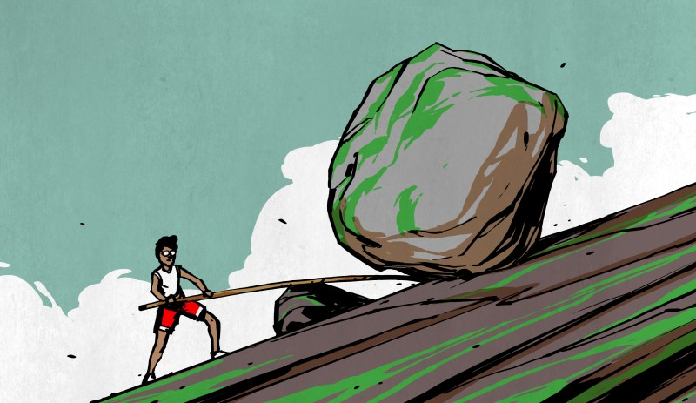
The capacity-efficiency model
Training improves overall cognitive capacity
Training improves the efficiency in using the available capacity
Training
Capacity
Efficiency
Transfer
increase muscle mass
learn to use leverage
von Bastian et al. (2022), Nature Reviews Psychology

Slide 16
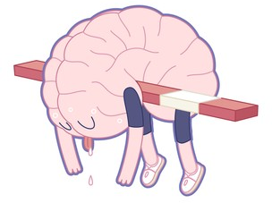

Some answers and many new questions
Cognitive training can support development of cognitive efficiency.
New questions:
Can cognitive efficiency be fostered more effectively?
How general are cognitive improvements through enhanced efficiency?
Little to no evidence for experience-based plasticity of capacity
De Simoni & von Bastian (2018)
Guye & von Bastian (2017)
Guye et al. (2017)
Himi et al. (in press)
Ripp et al. (2022)
Training
Capacity
Efficiency
Transfer

Slide 17
Videogaming & Esports as Brain Training

Slide 18

Cognitive benefits of videogaming?
Previous studies have produced inconsistent findings
Cognitive ability and videogaming are only weakly related.
Sala et al. (2018)
Cognitive ability and videogame skill are not only related, but videogaming can benefit cognition.
Bediou et al. (2018; 2023)
Smith & Basak (2023)

Slide 19
Possible explanations
Broad definitions of videogames
Small samples of relatively novice players
Short videogaming period (5 to 50 hours)
Limited assessment of videogame skill and expertise

Slide 20
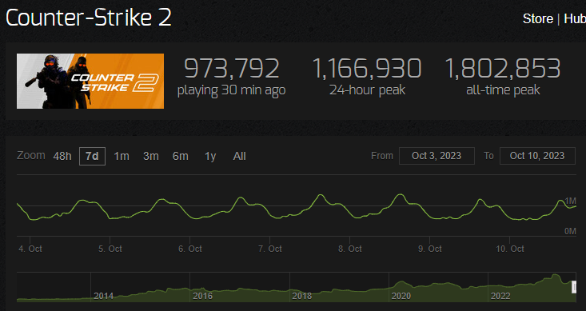

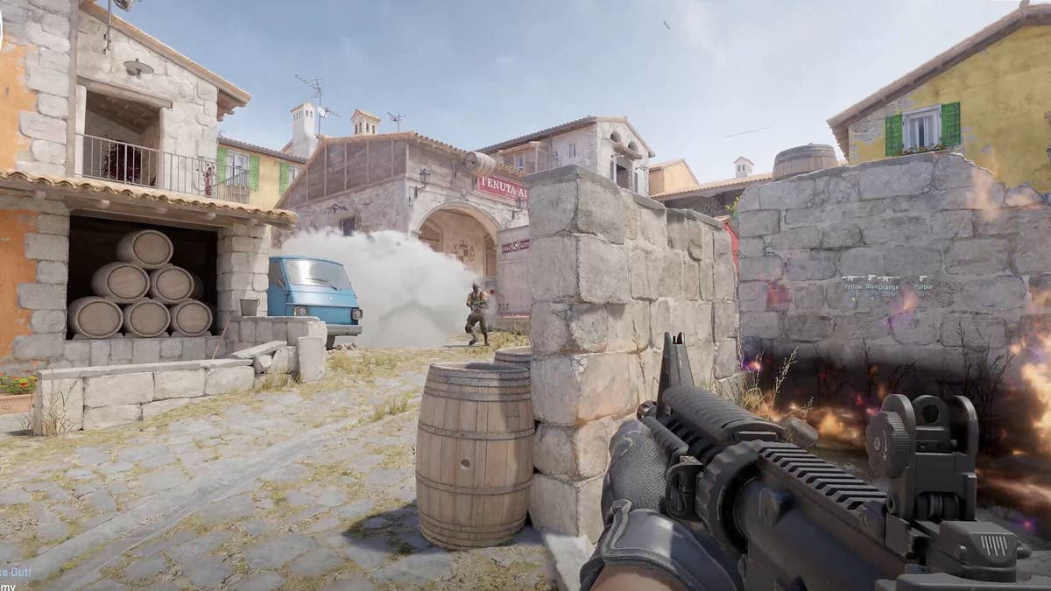
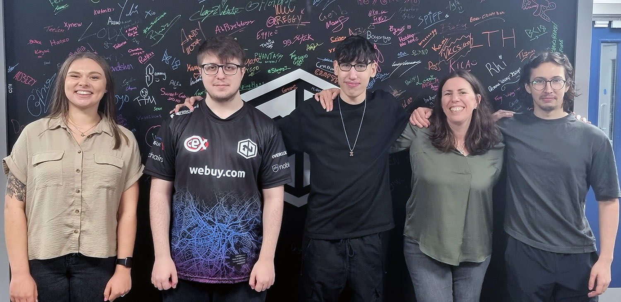
Efficiency in video gaming
Cognitive correlates of playing Counter-Strike

Slide 21
Processing Speed in Counter-Strike Players

Slide 22
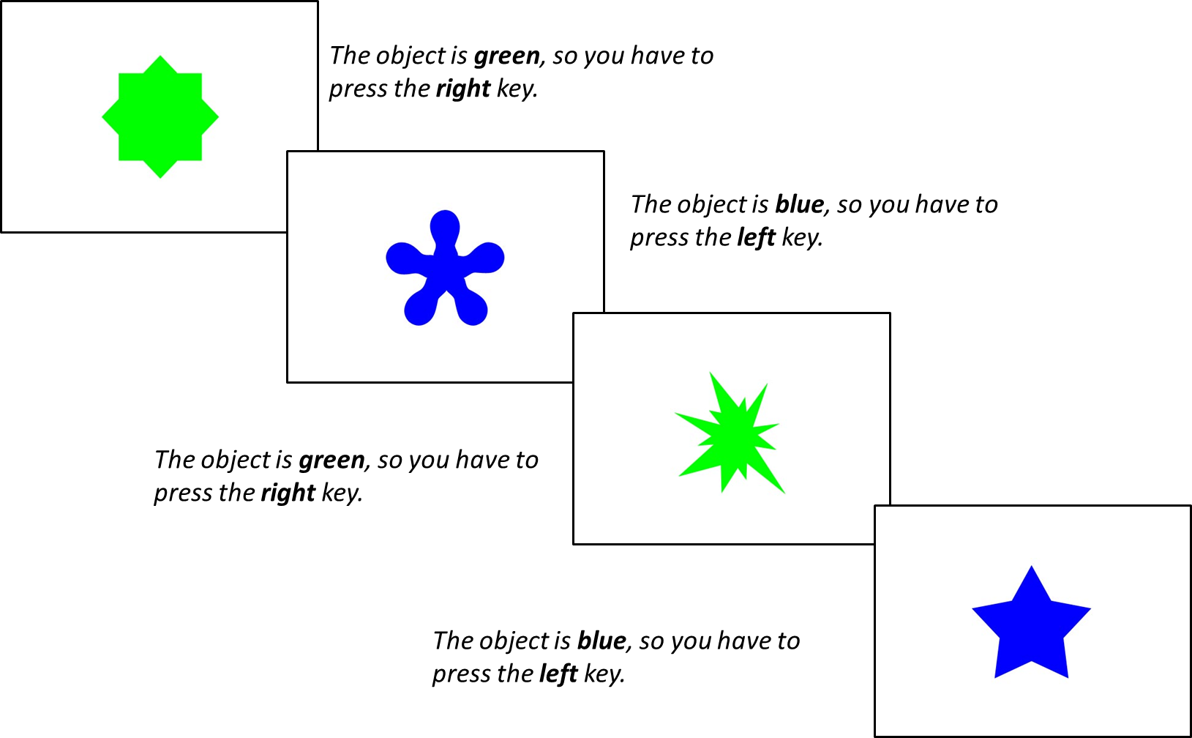

Processing Speed in Counter-Strike players
Cognitive correlates of playing Counter-Strike (N = 235)
Pro
Expert
Casual
CS survey
Colour-shape task
Measuring Reaction Times (RTs) and Accuracy Scores
Total hours playtime
Weekly hours playtime
Current Ranking (Standard MM)
Self-rated expertise
Hyde et al., in preparation
Notes:
Recruited via CS Discord Channels, large sample of N = 235, male-dominated (90%)
Completed colour-shape task, object appears on the screen and they had to decide if it is green/blue or curvy/spiky
Then completed a questionnaire, which was informed by three interviews we did with a Pro, Expert and Casual CS player beforehand. They identified a range of possible measures of CS expertise which we put into our questionnaire.
Key measures: thp, whp, cr, sre

Slide 23
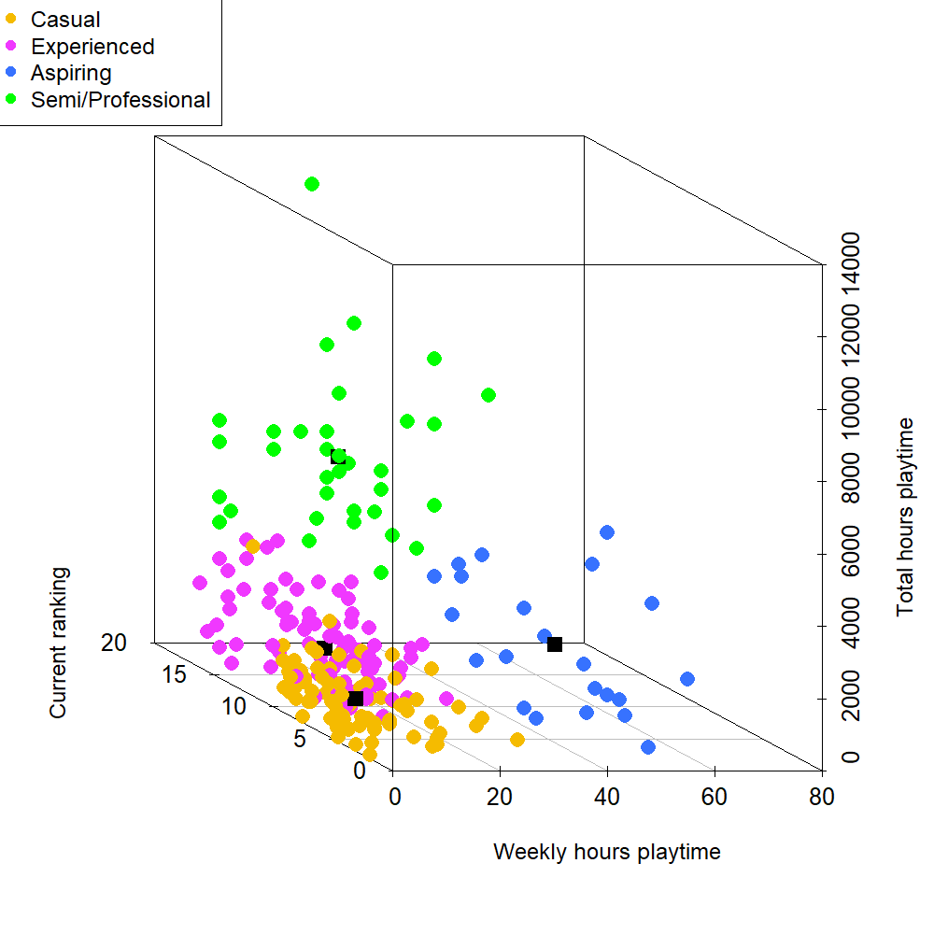
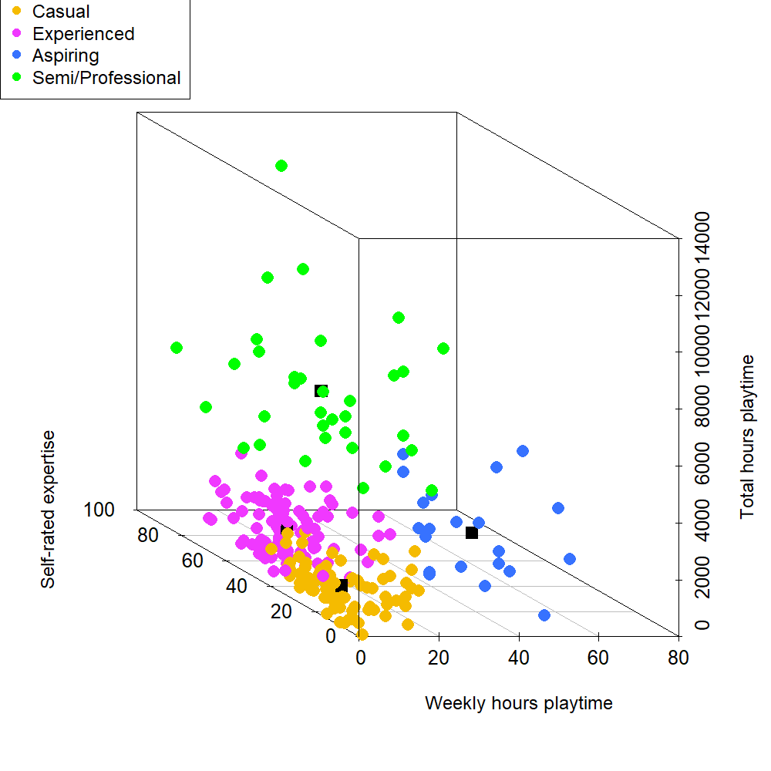
Processing Speed in Counter-Strike players
K-means cluster analysis: 4 groups of Counter-Strike experience
Semi/Professional
Aspiring
Experienced
Casual
Hyde et al., in preparation
Notes:
We conducted a k-means analysis, which takes the data from our four expertise variables, and places each participant into a cluster group based on their CS experience.
4 groups: semi/professionals, aspiring, experienced, causal
X= Weekly hours playtime, Y = Total hours playtime, X = Current Ranking or Self-rated expertise
Overview of the expertise of our sample (describe groups)
We had a great description of the sample, so next we looked at the cognitive correlates within this diverse sample

Slide 24

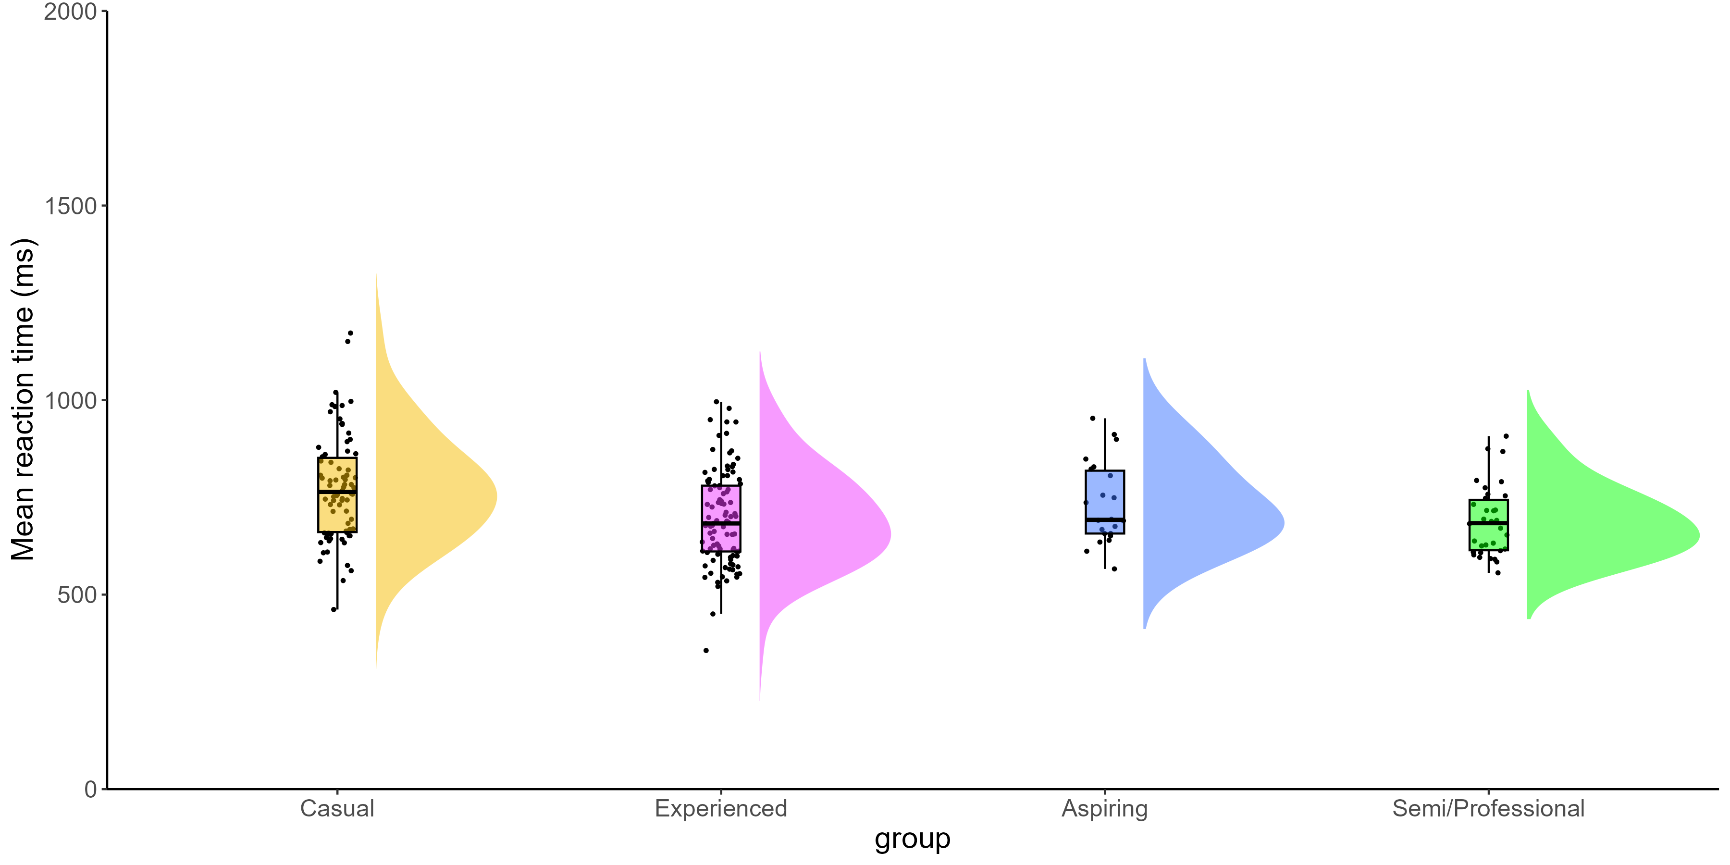

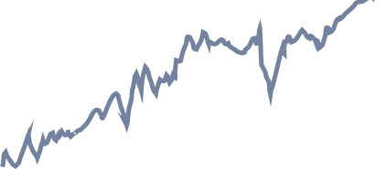
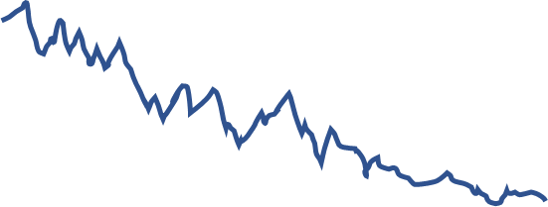

Processing Speed in Counter-Strike players
Expertise effects on Processing speed
No differences in accuracy, but Semi/Pro have the fastest RTs
Different
Non-decision time
Drift rate
Boundary
separation
Same
Hyde et al., in preparation
Notes:
Processing Speed = general ability to process information, typically measured with rts and accuracy scores
We found no differences in accuracy between our expertise groups, but we found highly expert CS players had faster RTs than less expert players
Suggesting that CS expertise is associated with faster processing speed performance, with no sacrifices in accuracy
Raincloud plot: x = RTs, y = groups
Dots = participant
Box plot = summarises data from each group in terms of the maximum, minimum, interquartile range and median
Cloud = distribution (normal distribution in the shape of a bell (semi/pro), but can be more skewed (casual)
We can investigate what’s behind these advantages in processing speed by diving deeper into RTs using a computational model
The model takes RTs and Accuracy Score measures and decomposes them into three new measures: boundary separation, drift rate and non-decision time
Drift rate = rate of information accumulation – how fast you are when gathering information during the task
Boundary separation = response caution – how careful you are when making your response during the task
Non-decision time = encoding and response execution – encoding is your first experience in perceiving and learning information from the task, response execution is literally the rate at which you hit the button for green/blue
These 3 measures give us a lot more detailed information about the processing speed of our players

Slide 25
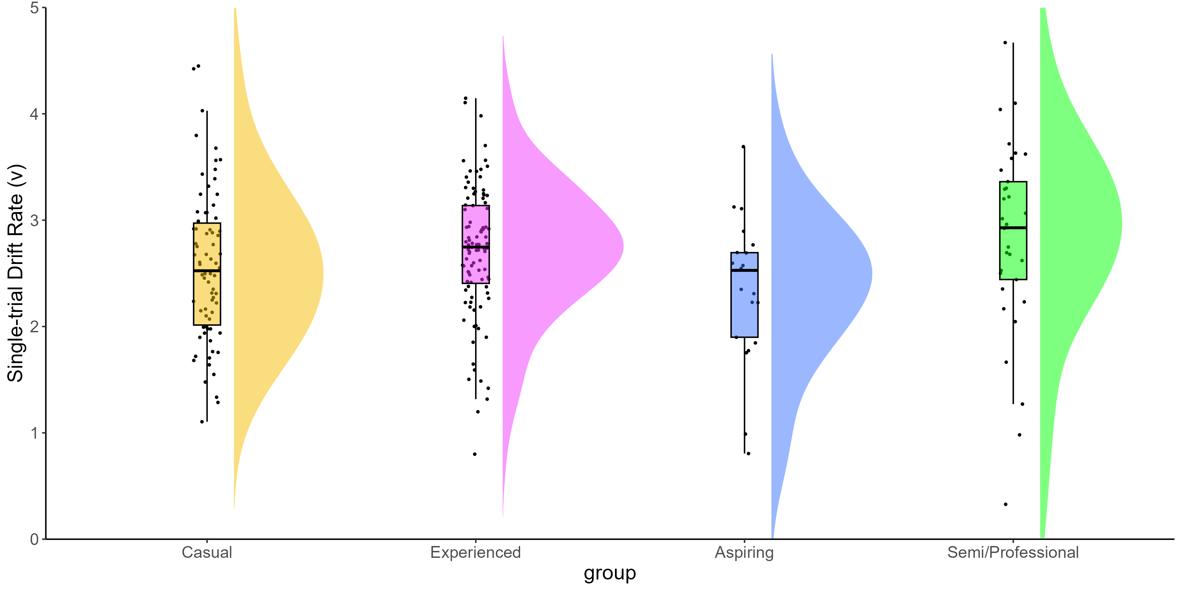
Processing Speed in Counter-Strike players
Expertise effects on evidence accumulation
Non-significant expertise effects on drift rate, but highly noisy data in semi/pro and experienced players.
Hyde et al., in preparation
Notes:
Drift rate = rate of information accumulation – how fast you are when gathering information during the task
More expert Semi/Pro players did show faster information accumulation but statistical tests showed that this effect was not significant, perhaps due to nosy data in our semi/professional players – cloud/distribution is very flat and wide compared to other groups

Slide 26
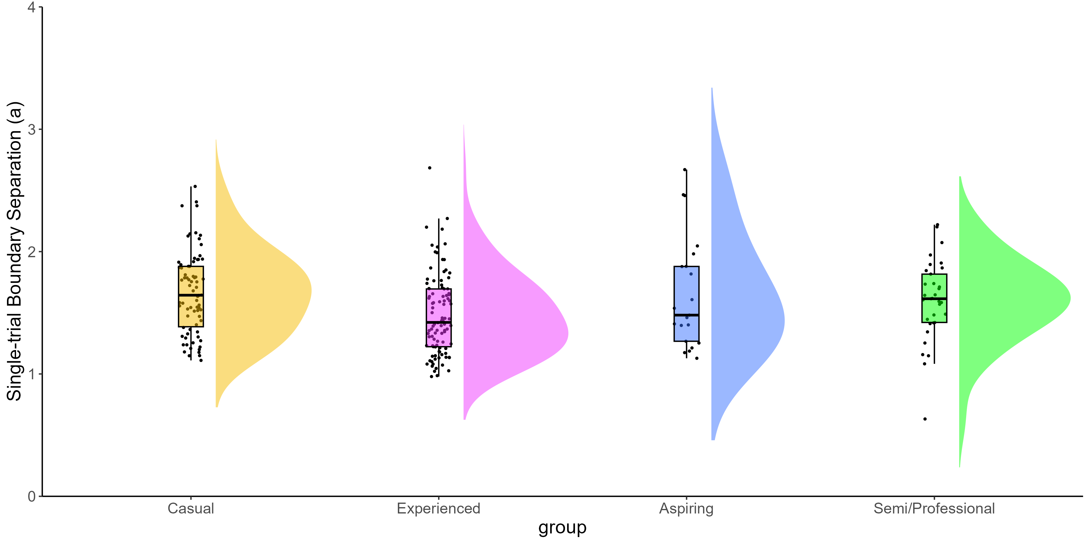
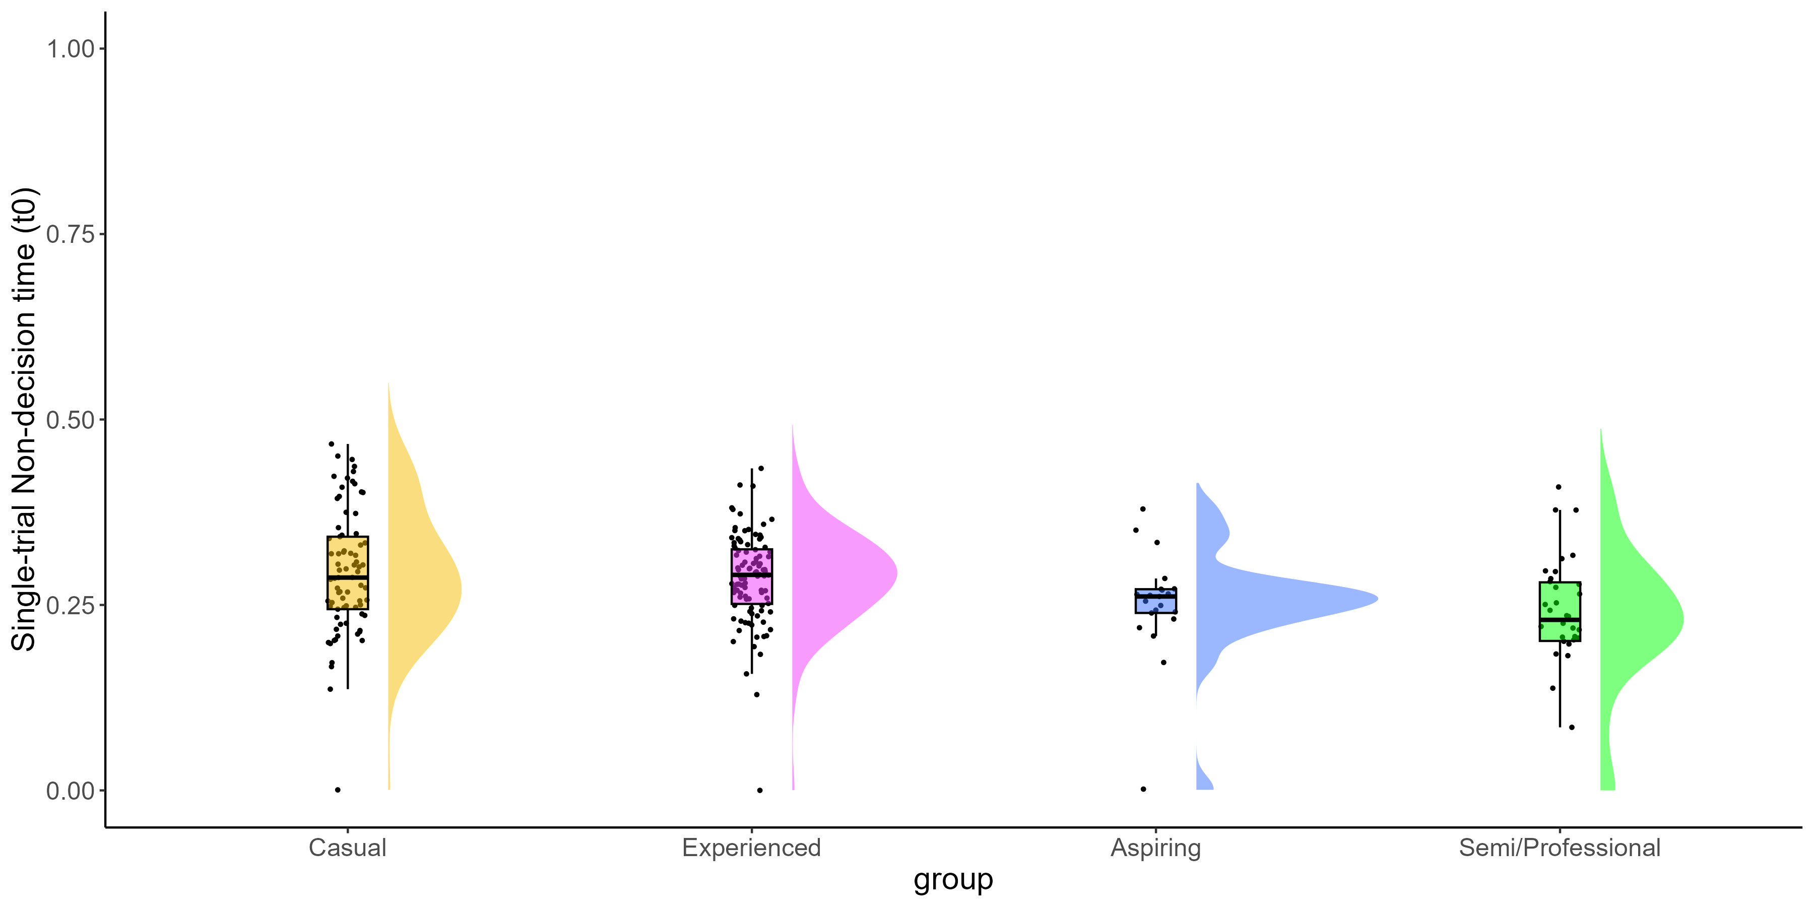
Processing Speed in Counter-Strike players
Expertise effects on strategy and non-decision time
No differences in boundary separation, but semi/pro players have shortest non-decision times.
Hyde et al., in preparation
Notes:
Boundary separation = response caution – how careful you are when making your response during the task
No differences between participants suggesting they were reasonably equally cautious in their responses
Non-decision time = encoding and response execution – encoding is your first experience in perceiving and learning information from the task, and response execution is literally the rate at which you hit the button for green/blue
Semi/Pro players had the shorted non-decision times, our more expert CS players were faster in perceiving and learning visual information from the task and in executing their response

Slide 27
Summary
CS expertise is a multi-dimensional construct that a range of measures can capture.
Highly expert CS players show advantages in processing speed.
Computational modelling demonstrates advantages in non-decision times.
K means clustering is one method, same in other samples, with other measures?
Faster RTs with no impact on Accuracy Scores
Better able to encode and respond to visual information
Notes:
K means clustering was a viable method for this sample, but will we find the same cluster groups in other samples?
Will these 4 measures apply as well to other video games, or will we need new measures for different FPS games?
Perceive, learn and respond to visual information - what does this mean?

Slide 28
Conclusions
Videogaming is related to better cognitive efficiency.
Videogames as brain training?
Perspective & environment
Sound & music
Balance
Levels
UI
Competitive play
Interaction with players
…
Little to no evidence for experience-based plasticity of capacity
De Simoni & von Bastian (2018)
Guye & von Bastian (2017)
Guye et al. (2017)
Himi et al. (in press)
Ripp et al. (2022)
Training
Capacity
Efficiency
Transfer
Notes:
Perhaps we can use video games as brain training and help them improve their RTs and Encoding abilities
Relevant for individuals with slow processing speed: dyslexia (myself!), ADHD, ASD, as well as older adults (60+) who show slower processing speed as they age
But, there’s a lot more work to be done before we get your grandparents into our labs and ask them to play CS
We need to really understand the cognitive correlates of playing video games, and the mechanisms within these games which foster cognitive advantages

Slide 29








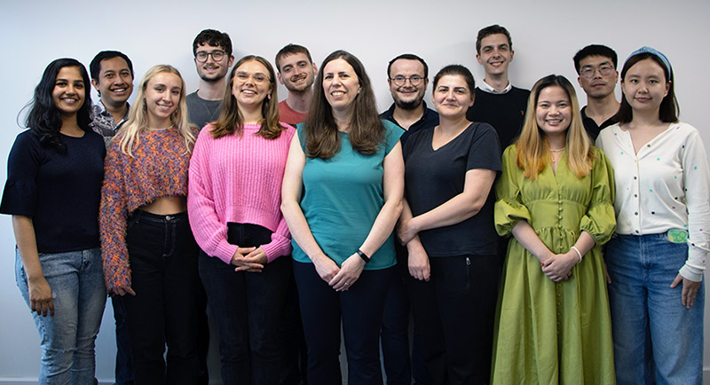
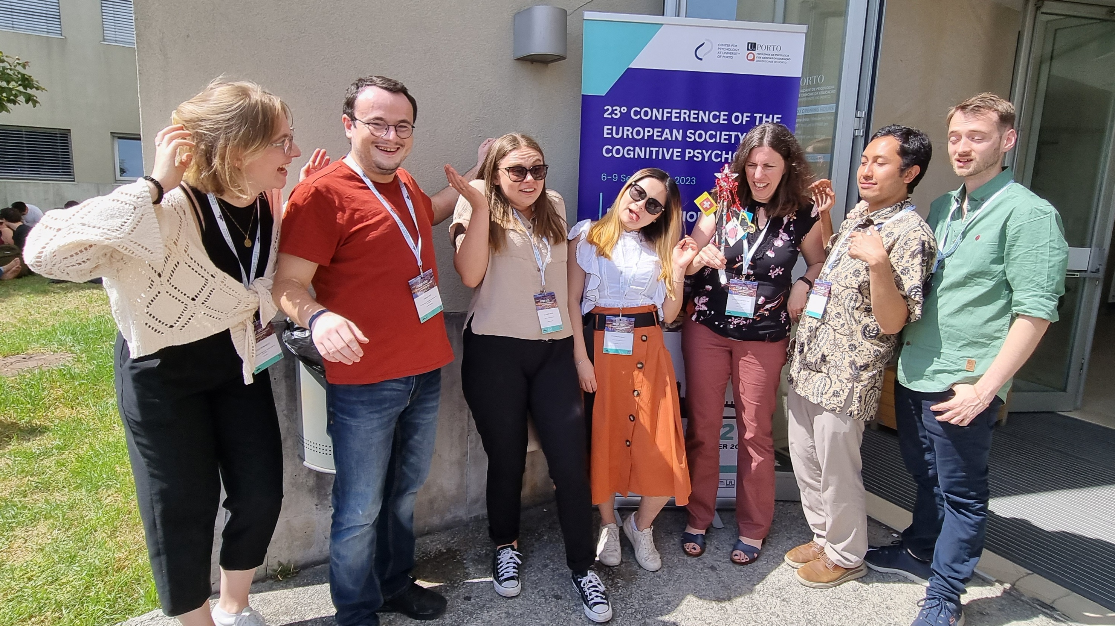
Cognitive Ability & Plasticity Lab
University of Sheffield
c.c.vonbastian@sheffield.ac.uk www.claudiavonbastian.com
@cvonbastian www.tatool-web.com
@cvonbastian.bsky.social

